Slide 1
Title
Presenter / Job Title

Slide 2
Template User Guide
This template follows the branded Diamanti color and font guide as designed by the Corporate Marketing Team.
Color should be chosen from the theme colors only or variations in shades just under the theme colors. Following this guide will allow presentations, website materials, social media materials and any other form of communication to have a consistent company impression.
The brand fonts are Libre Franklin for headers and titles and Trasandena for all other content. Fonts can be downloaded from the brand site. Do NOT use other fonts (to maintain one corporate brand impression).
Multiple layouts have been designed using the brand colors and font. To choose a layout for your slide, go to Home and click Layouts. Multiple options for title slides, section transitions and content slides have been designed to allow consistent placement and color in the presentations.
Presentation size. Due to the many layout options, the file size is larger than necessary. Once your presentation is complete, go to View, Slide Master, and delete all the layouts not used and the file size will decrease. Additionally, the slides included in this presentation as a start can be deleted as all are for reference or re-use as needed. Additionally, if the presentation includes significant graphics, title slides without the diamond background have been included to reduce file size.

Slide 3
To Save this Template as Your Default Template
Open the file
Click File / Save As
Click the file drop down and select Powerpoint Template (*.potx). This will automatically change the folder location to your personal templates folder. Name it Diamanti_2019_Confidential, click save.
Now go into Powerpoint, select new file and go to personal tab. You should see the new template there. Right click and select pin it. This will pin it to your themes. Going forward, the theme will be pinned to your Powerpoint start-up.

Slide 4
Confidentiality Notice
The content of this presentation is proprietary and confidential information of Diamanti, Inc. It is not intended to be distributed to any third party without the written consent of Diamanti.

Slide 5
Standard table layout
 | Column | Column | Column | Column | Column | Column | Column
Row
Row
Row
Row
Row
Row
Row

Slide 6
Organization Chart
Insert Name
Role
Insert Name
Role
Insert Name
Role
Insert Name
Role
Insert Name
Role
Insert Name
Role
Insert Name
Role
Insert Name
Role
Insert Name
Role
Insert Name
Role
Insert Name
Role
Insert Name
Role
Insert Name
Role
Insert Name
Role
Insert Name
Role
Insert Name
Role
Insert Name
Role
Insert Name
Role
Insert Name
Role
Insert Name
Role
Insert Name
Role
Insert Name
Role
Insert Name
Role
Insert Name
Role
Insert Name
Role
Insert Name
Role
Insert Name
Role
Insert Name
Role
Insert Name
Role
Insert Name
Role
Insert Name
Role

Slide 7

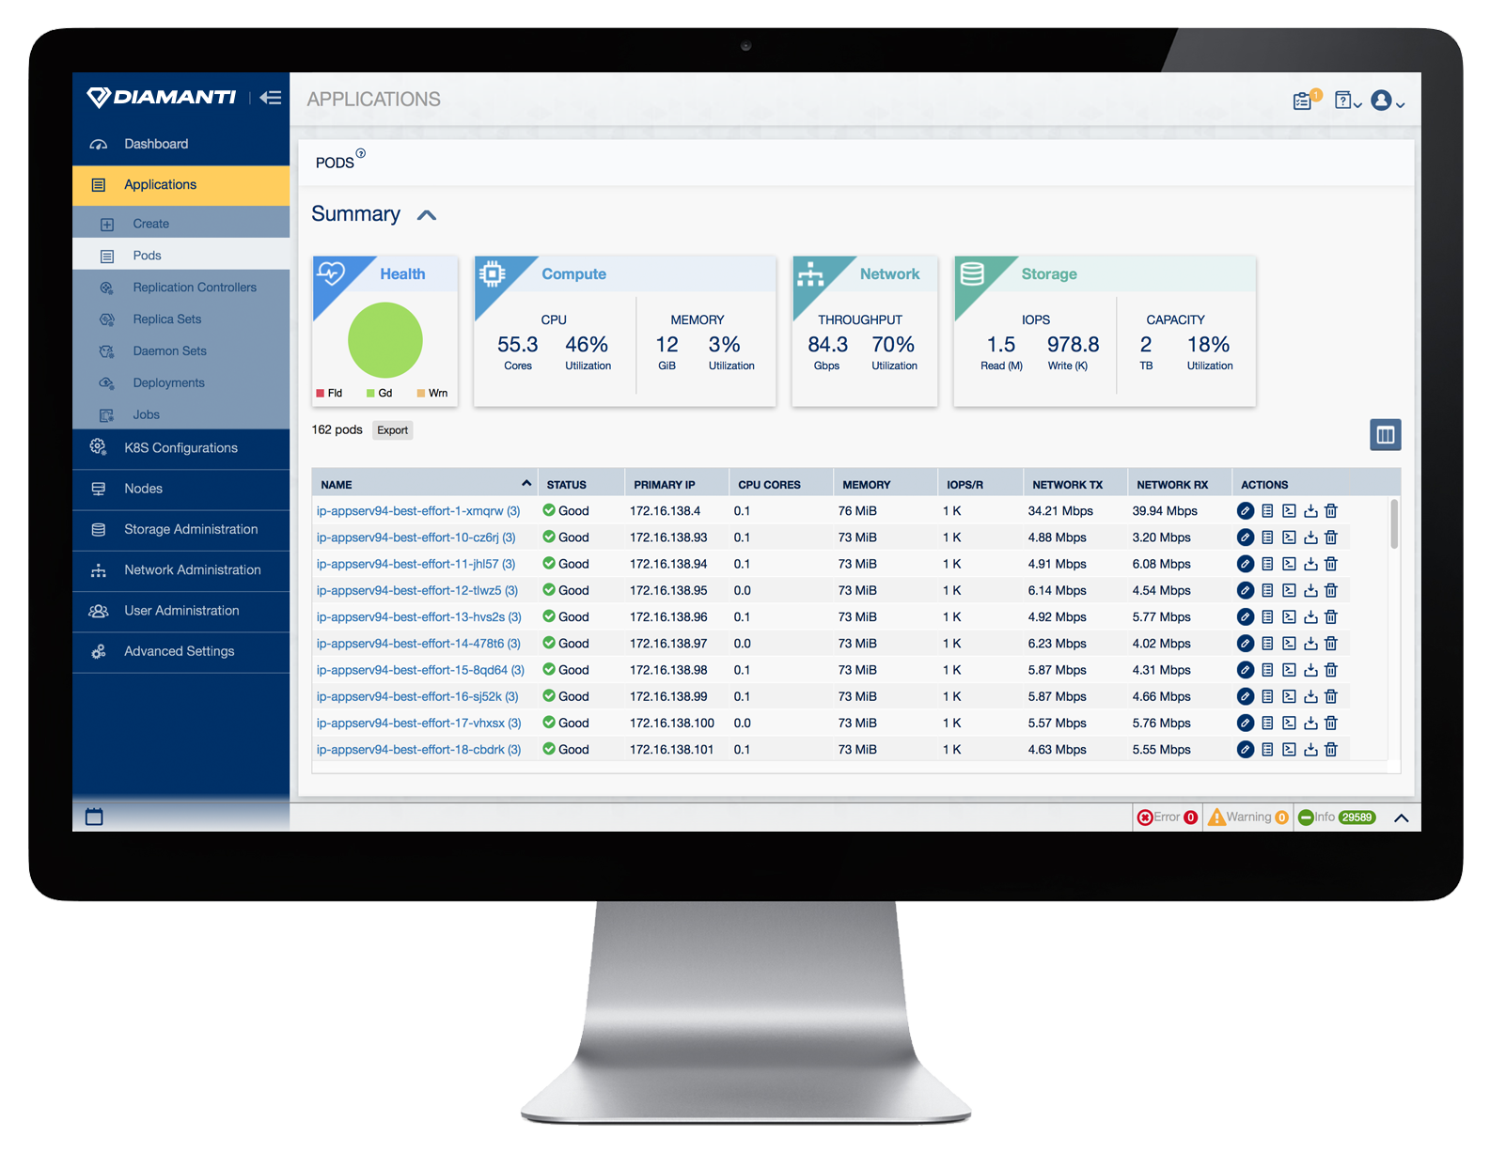
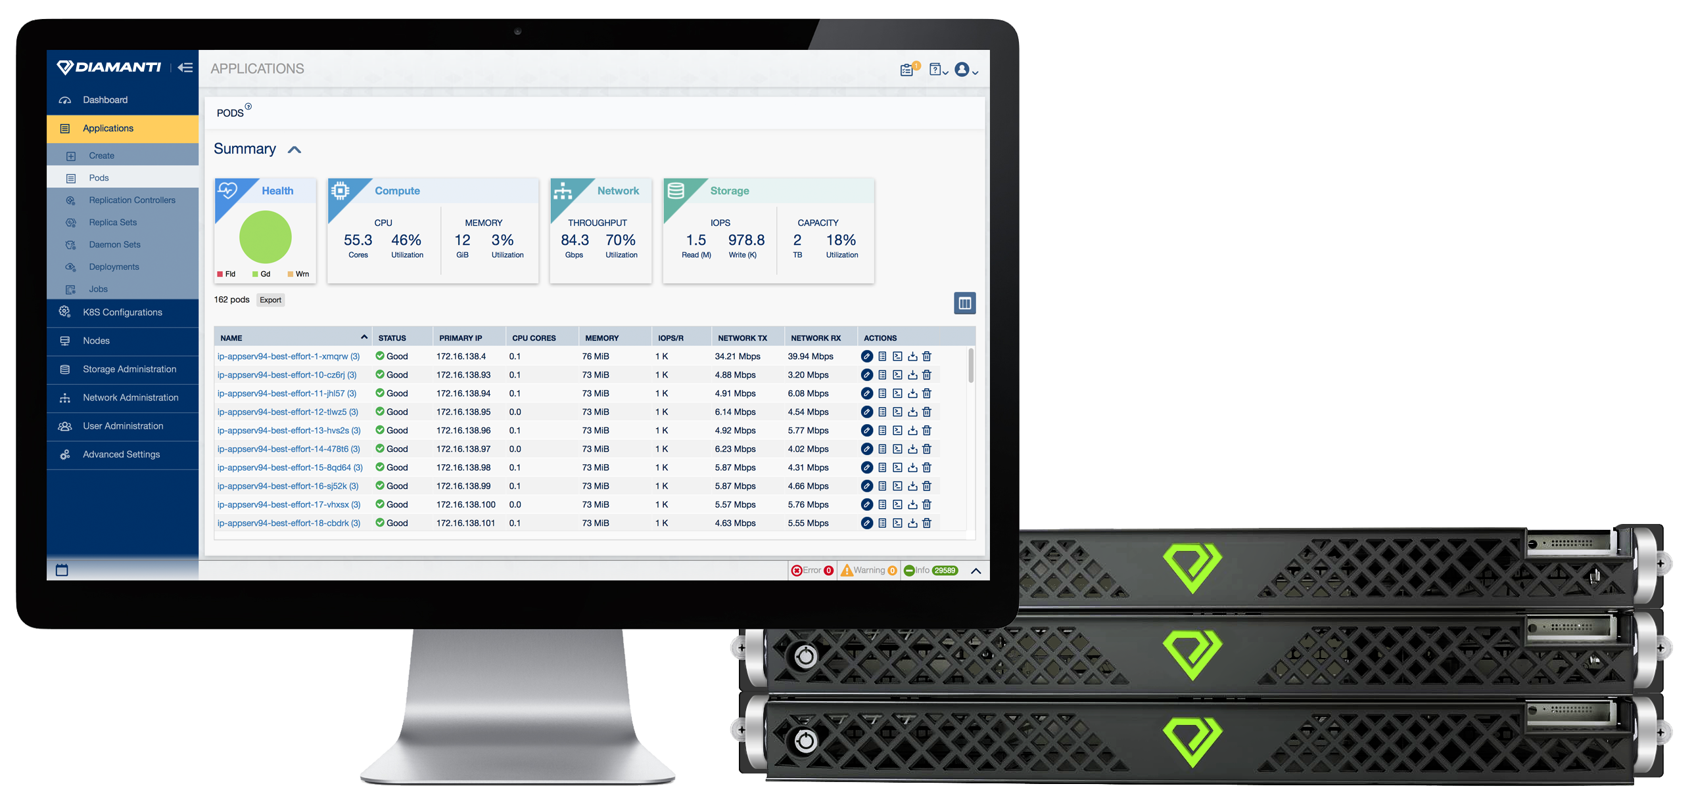
User Images

Slide 8




User Images

Slide 9






Icons
(additional icons for compute, network, storage, array, flash, etc., are in production)

